Slide 1

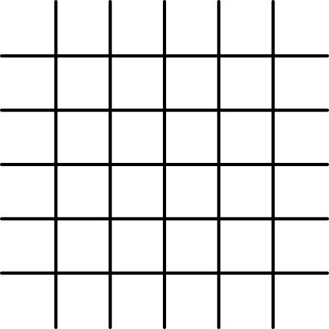



English Grammar Guide
PAST PERFECT CONTINUOUS TENSE
with Ms. Chiaki Sato

Slide 2
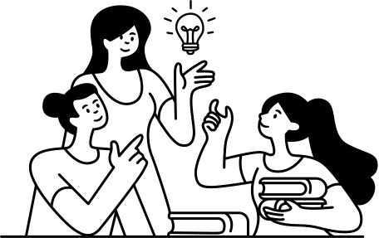

LEARNING OBJECTIVES
Understand the concept of Past Perfect Continuous Tense.
In this presentation, we'll delve into the Past Perfect Continuous Tense and its relevance in daily life.
Learn how to form sentences in the past perfect continuous tense.
We'll uncover the rules for crafting sentences in the past perfect continuous tense with practical examples.
Practice using Past Perfect Continuous Tense in real-life situations.
You'll have opportunities to apply this tense in various everyday scenarios.

Slide 3

DEMYSTIFYING THE PAST PERFECT CONTINUOUS TENSE
  The Past Perfect Continuous Tense is used to describe actions that were ongoing in the past and had a duration before something else happened.
  It is formed using "had been" + the base form of the verb + "-ing."

Slide 4

CRAFTING THE PAST PERFECT CONTINUOUS TENSE
To form the Past Perfect Continuous Tense, use "had been" followed by the base form of the verb + "-ing."
+
Subject + Had been + V-ing
  They had been playing tennis.
-
Subject + Had Not / Hadn’t + Been + V-Ing
  They Hadn’t been playing tennis.
?
Had + S + Been + V-Ing?
  Had they been playing tennis?

Slide 5


FURTHER INSIGHTS
The Past Perfect Continuous Tense helps us convey the idea that an action was in progress for some time before something else occurred.
Example: He had been working at the company for five years when he decided to retire.
Did you know that the Past Perfect Continuous Tense is often used to emphasize the duration of an action in the past?

Slide 6

REAL-LIFE EXAMPLES
  He study for the exam for hours before the phone rang.
Correct Answer: She had been studying for the exam for hours before the phone rang.
  They play basketball all afternoon before it started raining.
They had been playing basketball all afternoon before it started raining.
  He work on the project for weeks when he finally completed it.
Correct Answer: He had been working on the project for weeks when he finally completed it.

Slide 7

LET'S APPLY IT!
Exercise: Complete the sentences with the correct Past Perfect Continuous Tense form.
She
a book for hours before she fell asleep.
They
their musical instruments all morning before the concert.
He
a marathon for two hours when he reached the finish line.
had been
reading
had been
running
had been practicing

Slide 8
QUIZ TIME!
Fill in the blanks with the correct Past Perfect Continuous Tense form.
  She
at the party for hours before she
tired.
  They
line for tickets all afternoon before the concert
  I
English for months before I
the proficiency test.
  The chef
dinner for hours before the guests
  She
in the pool for hours before she
she had forgotten her towel.
  They
a sandcastle for hours before the tide
it away.
  He
on the car for hours before it
again

Slide 9
CHOICE QUIZ
Choose the correct Past Perfect Continuous Tense sentence.
  She (had been / has been) practicing the piano for hours before the concert.
  They (were / had been) playing in the park all afternoon before the rain started.
  He (had been / has been) studying for the test for days before he aced it.
  We (are / had been) walking in the forest when we found the hidden treasure.
  The workers (had been / have been) building the bridge for months before it was completed.

Slide 10

SPOT THE MISTAKE IN THE STORY
Read the story and find the mistakes in the use of Past Perfect Continuous Tense. Correct the sentences.
Yesterday, Sarah was tired because she had run a marathon. She had been running for hours when she crossed the finish line. Then, she ate a delicious meal.

Slide 11
THANK YOU FOR EXPLORING DAILY LIFE WITH PAST PERFECT CONTINUOUS TENSE!
Thank you for joining us on this journey through daily life with the Past Perfect Continuous Tense. May your language skills continue to flourish!

Slide 12
TEACHER RESOURCES PAGE
  Find the magic and fun in presenting. Press the following keys while on Present mode!
B
C
D
  for Blur
  for Confetti
  for a Drumroll
O
Q
X
  for Bubbles
  for Quiet
  to Close
  Any number from 0-9 for a timer.

